Slide 1
Recurrent Neural Network
Presented by Muhammad Zaqeem

Slide 2
Overview:
Sequential Data
Why Recurrent Neural Network
Recurrent Neural Network
Forward Propagation in RNN
Type/Different Architecture of RNN
Backpropagation in RNN
Problem in RNN

Slide 3
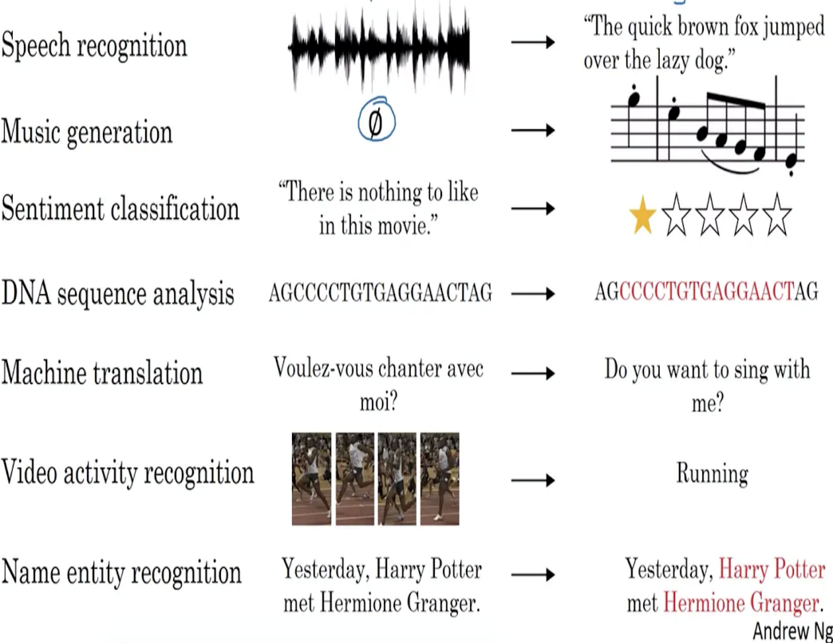
Sequential Data:
Sequential data is any data where the order or sequence of elements matters.
It contains patterns or dependencies essential for understanding its meaning.
Changing the order can lead different meaning or make it meaningless
Sequential data typically exhibits temporal or chronological relationships.
Sequence Data at Work Real-World Applications and Examples.

Slide 4
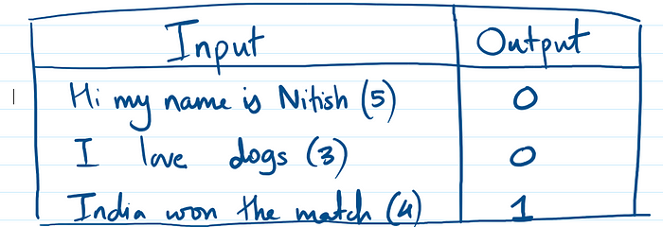
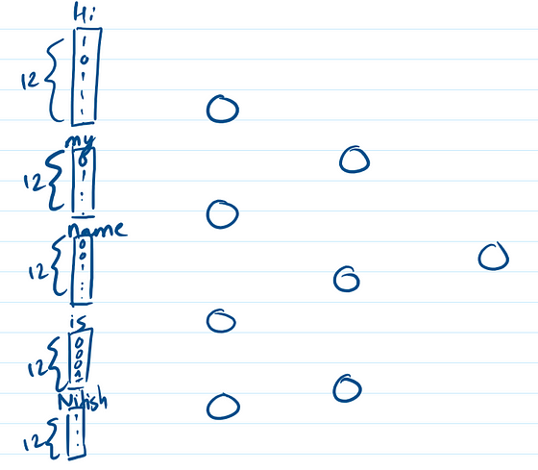
Why Recurrent Neural Network
Feedforward Neural Network can not handle sequential data there are some problem in it.
Variable Input Size:
Sentences vary in length, but ANN requires fixed-size input.
Zero Padding:
Padding increases memory and computation, and may not work with longer test sentences.
No Memory:
ANN lacks the ability to retain word order, losing contextual information.
Input Texts and Their Output Sentiments.
Fitting Texts data into ANN

Slide 5

Recurrent Neural Network
Recurrent Neural Networks (RNNs) are a type of neural network designed for sequential data (e.g., text, time series, speech).
The output from previous steps as input for the current step, allowing them to retain memory and understand context.
RNNs can handle variable-length input sequences.
They are particularly useful for tasks like text classification, language modeling, speech recognition, and machine translation.
The Architecture of RNN

Slide 6
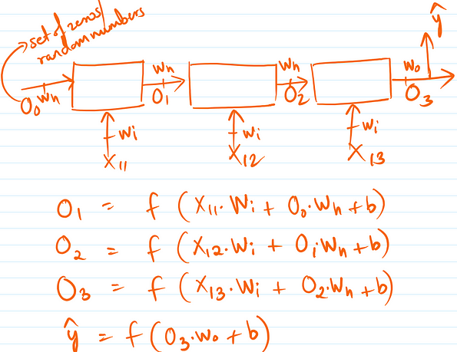
Forward Propagation in RNN
Current Hidden State (ht):
The current hidden state (ht​) is calculated using the previous hidden state (ht−1​) and the current input (xt​).
Formula: ht=tanh⁡(Wx⋅xt+Wh⋅ht−1+b)
Here, tanh is used as the activation function to ensure the values stay between -1 and 1.
Output (yt):
In some applications, the hidden state at each time step is passed through another set of weights to produce the output.
Formula: yt = Wy ⋅ ht + by
Where Wy​ is the output weight, and by​ is the bias for the output.
Flowing data (O1,O2,O3) in forward direction

Slide 7
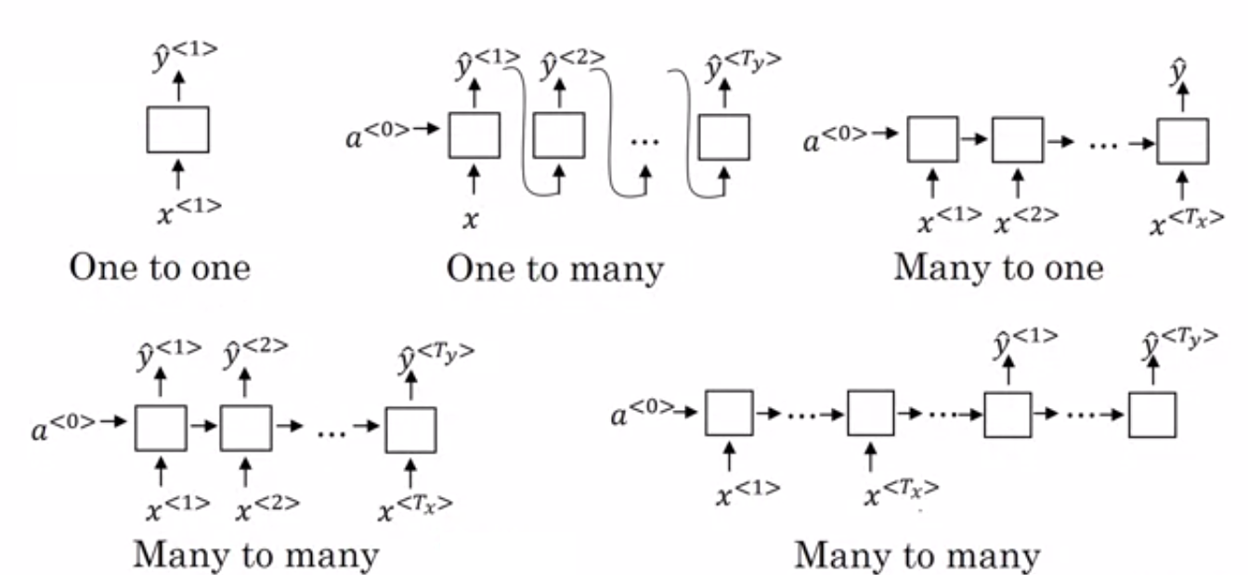
Type of RNN
One-to-Many:
Single input followed by a sequence of outputs(Image captioning).
Many-to-One:
Sequence of inputs followed by a single output(Sentiment analysis).
Many-to-Many (Equal Length):
Sequence of inputs and outputs of the same length(Time Series)
Many-to-Many (Unequal Length):
Sequence of inputs and outputs with different lengths(Machine translation).
Data Relationships in RNN

Slide 8
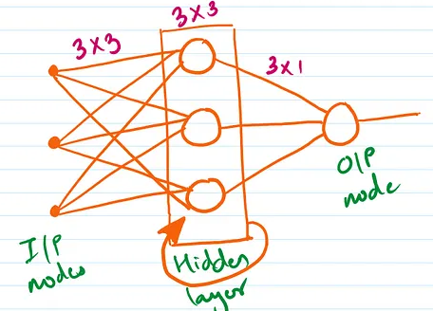
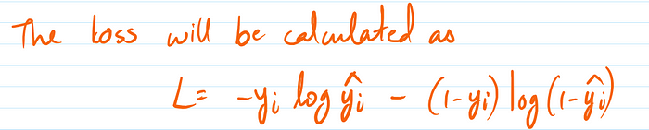
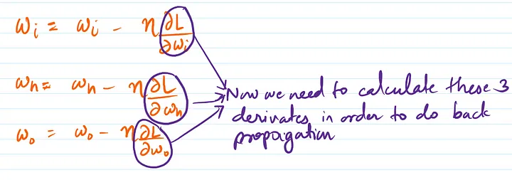
Back Propagation in RNN
The RNN architecture by taking 3 nodes in the hidden layer and 1 node in the output layer
We have to minimize this loss by using gradient descent.
We have to find the values of wi, wh and wo such that the loss function minimizes

Slide 9
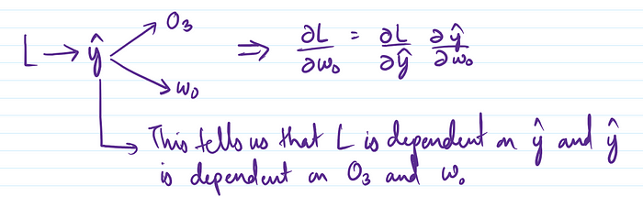
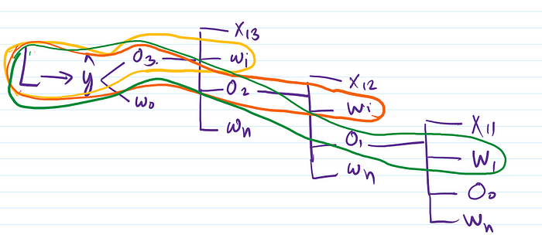

For calculation of dl/dwi:
Here the above diagram can be interpreted as Loss is dependent on yhat, yhat is dependent on O3 and wo, O3 is dependent on X13, wi, O2 and wh, O2 is dependent on X12, wi, O1, wh, O1 is dependent on X11, wi, Oo,wh.
So to go from L to wi, there are three routes so at the end, all of these three paths will be added
Similarly we can calculate the value of dl/dwh

Slide 10
Problem in RNN
Long-Term Memory Issue:
RNN forget information from earlier in a sequence, especially as the sequence gets longer. This happens because the network’s learning gets weaker over time (vanishing gradient).
Solution:
Use LSTM networks.
Exploding Gradients Sometimes the learning process causes very large numbers (gradients) that make it hard for the network to learn correctly.
Solution:
Use gradient clipping

Slide 11


